Slide 1

Chapter 5
Linear Algebra
Eigenvalues and Eigenvectors

Slide 2
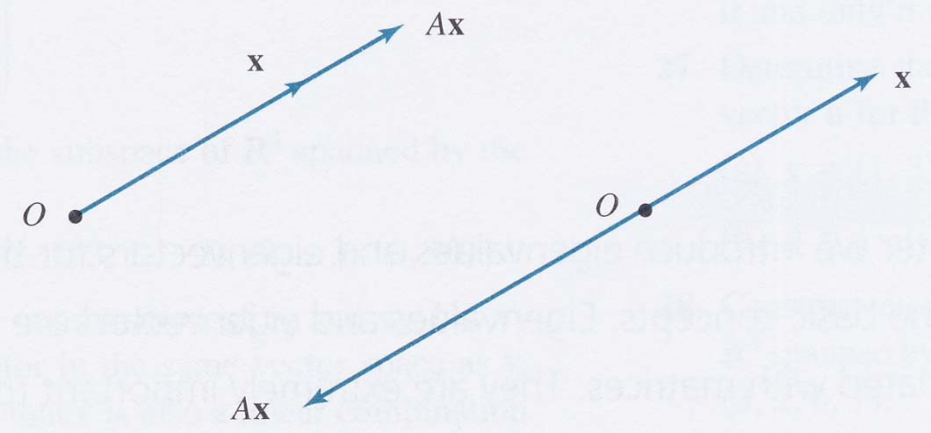
5.1 Eigenvalues and Eigenvectors
Definition
Let A be an n × n matrix. A scalar λ is called an eigenvalue of A if there exists a nonzero vector x in R^{n} such that
Ax = λx.
The vector x is called an eigenvector corresponding to λ.
Figure 5.1
Ch5_<number>

Slide 3
Computation of Eigenvalues and Eigenvectors
Let A be an n × n matrix with eigenvalue λ and corresponding eigenvector x. Thus Ax = λx. This equation may be written
Ax – λx = 0
given
(A – λI_{n})x = 0
Solving the equation |A – λI_{n}| = 0 for λ leads to all the eigenvalues of A.
On expending the determinant |A – λI_{n}|, we get a polynomial in λ. This polynomial is called the characteristic polynomial of A.
The equation |A – λI_{n}| = 0 is called the characteristic equation of A.
Ch5_<number>

Slide 4
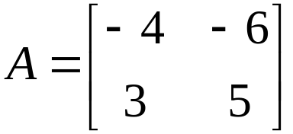
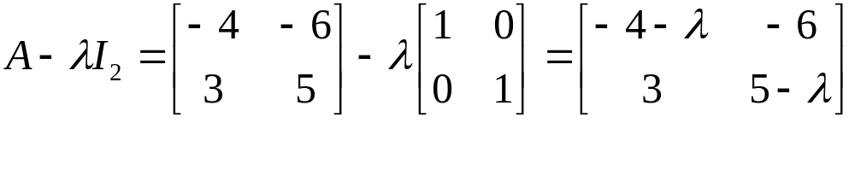
Example 1
Find the eigenvalues and eigenvectors of the matrix
Solution
Let us first derive the characteristic polynomial of A.
We get
We now solve the characteristic equation of A.
The eigenvalues of A are 2 and –1.
The corresponding eigenvectors are found by using these values of λ in the equation(A – λI₂)x = 0. There are many eigenvectors corresponding to each eigenvalue.
Ch5_<number>

Slide 5
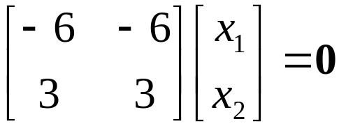
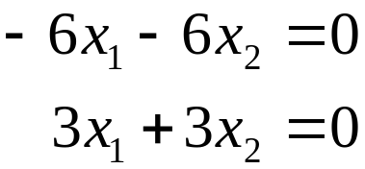
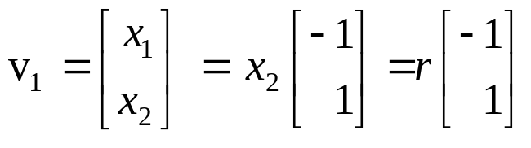
For λ = 2
We solve the equation (A – 2I₂)x = 0 for x.
The matrix (A – 2I₂) is obtained by subtracting 2 from the diagonal elements of A. We get
This leads to the system of equations
giving x₁ = –x₂. The solutions to this system of equations are x₁ = –r, x₂ = r, where r is a scalar. Thus the eigenvectors of A corresponding to λ = 2 are nonzero vectors of the form
Ch5_<number>

Slide 6
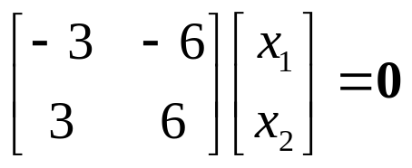
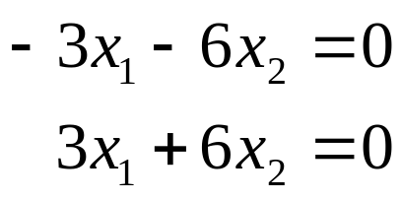
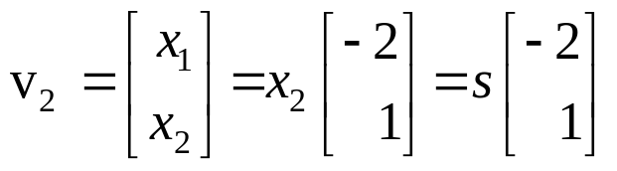
For λ = –1
We solve the equation (A + 1I₂)x = 0 for x.
The matrix (A + 1I₂) is obtained by adding 1 to the diagonal elements of A. We get
This leads to the system of equations
Thus x₁ = –2x₂. The solutions to this system of equations are x₁ = –2s and x₂ = s, where s is a scalar. Thus the eigenvectors of A corresponding to λ = –1 are nonzero vectors of the form
Ch5_<number>

Slide 7
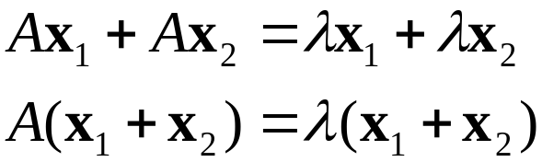

Theorem 5.1
Let A be an n × n matrix and λ an eigenvalue of A. The set of all eigenvectors corresponding to λ, together with the zero vector, is a subspace of R^{n}. This subspace is called the eigenspace of λ.
Proof
Let x₁ and x₂ be two vectors in the eigenspace of λ and let c be a scalar. Then Ax₁ = λx₁ and Ax₂ = λx₂. Hence,
Thus is a vector in the eigenspace of λ. The set is closed under addition.
Ch5_<number>

Slide 8
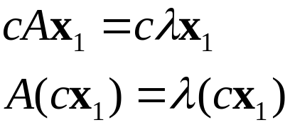
Further, since Ax₁ = λx₁,
Therefore cx₁ is a vector in the eigenspace of λ. The set is closed scalar multiplication.
Thus the set is a subspace of R^{n}.
Ch5_<number>

Slide 9

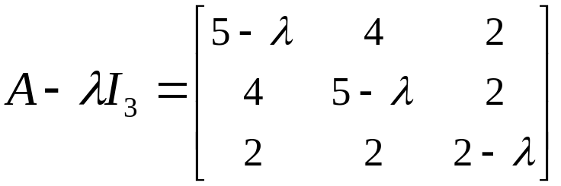
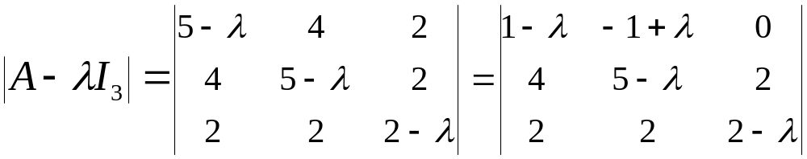
Example 2
Find the eigenvalues and eigenvectors of the matrix
Solution
The matrix A – λI₃ is obtained by subtracting λ from the diagonal elements of A.Thus
The characteristic polynomial of A is |A – λI₃|. Using row and column operations to simplify determinants, we get
Ch5_<number>

Slide 10
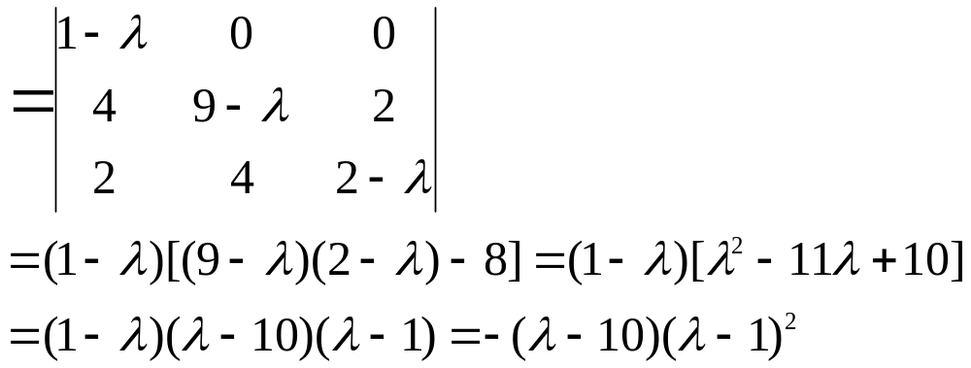
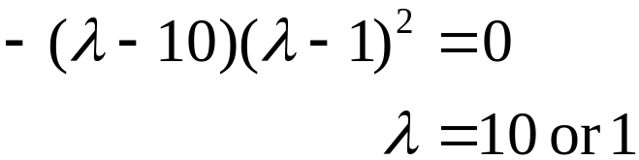
We now solving the characteristic equation of A:
The eigenvalues of A are 10 and 1.
The corresponding eigenvectors are found by using three values of λ in the equation (A – λI₃)x = 0.
Ch5_<number>

Slide 11
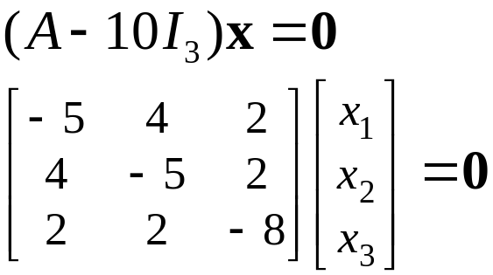

λ₁ = 10
We get
The solution to this system of equations are x₁ = 2r, x₂ = 2r, and x₃ = r, where r is a scalar.
Thus the eigenspace of λ₁ = 10 is the one-dimensional space of vectors of the form.
Ch5_<number>

Slide 12
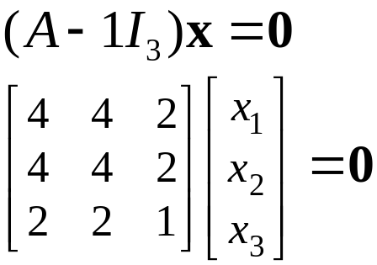

λ₂ = 1
Let λ = 1 in (A – λI₃)x = 0. We get
The solution to this system of equations can be shown to be x₁ = – s – t, x₂ = s, and x₃ = 2t, where s and t are scalars. Thus the eigenspace of λ₂ = 1 is the space of vectors of the form.
Ch5_<number>

Slide 13
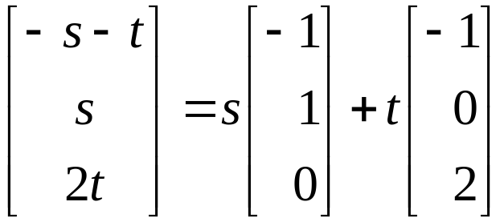
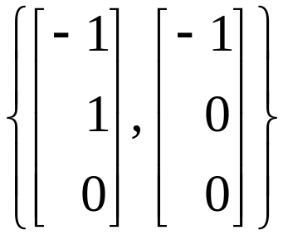
Separating the parameters s and t, we can write
Thus the eigenspace of λ = 1 is a two-dimensional subspace of R³ with basis
If an eigenvalue occurs as a k times repeated root of the
characteristic equation, we say that it is of multiplicity k.
Thus λ=10 has multiplicity 1, while λ=1 has multiplicity 2
in this example.
Ch5_<number>

Slide 14
Homework
Exercise 3.4 p.186:
1, 4, 9, 11, 13, 15, 24, 26, 32
Ex24: Prove that if A is a diagonal matrix, then its eigenvalues are
the diagonal elements.
Ex26: Prove that if A and A^{t} have the same eigenvalues.
Ex32: Prove that the constant term of the characteristic polynomial
of a matrix A is |A|.
Ch5_<number>

Slide 15
5.3 Diagonalization of Matrices
Definition
Let A and B be square matrices of the same size. B is said to be similar to A if there exists an invertible matrix C such that
B = C^{–1}AC. The transformation of the matrix A into the matrix B in this manner is called a similarity transformation.
Ch5_<number>

Slide 16
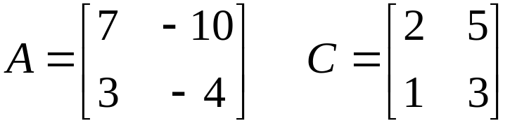
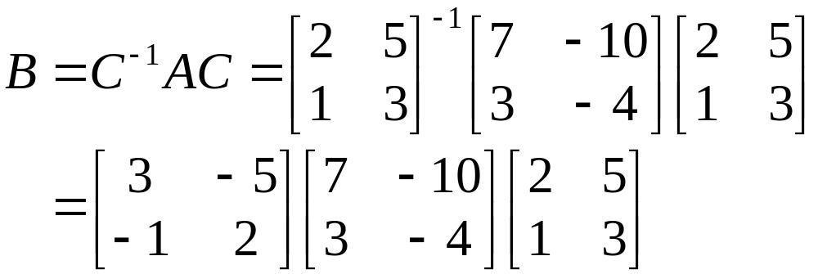
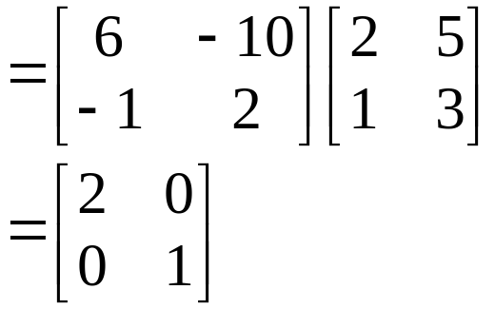
Example 3
Consider the following matrices A and C with C is invertible.
Use the similarity transformation C^{–1}AC to transform A into a matrix B.
Solution
Ch5_<number>

Slide 17
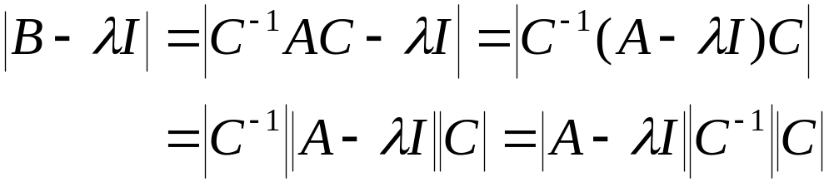
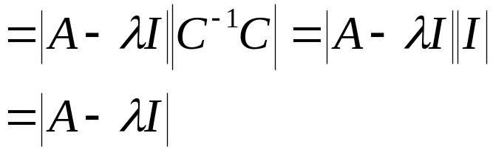
Theorem 5.3
Similar matrices have the same eigenvalues.
Proof
Let A and B be similar matrices. Hence there exists a matrix C such that B = C^{–1}AC.
The characteristic polynomial of B is |B – λI_{n}|. Substituting for B and using the multiplicative properties of determinants, we get
The characteristic polynomials of A and B are identical. This means that their eigenvalues are the same.
Ch5_<number>

Slide 18
Definition
A square matrix A is said to be diagonalizable if there exists a matrix C such that D = C^{–1}AC is a diagonal matrix.
Theorem 5.4
Let A be an n × n matrix.
If A has n linearly independent eigenvectors, it is diagonalizable. The matrix C whose columns consist of n linearly independent eigenvectors can be used in a similarity transformation C^{–1}AC to give a diagonal matrix D. The diagonal elements of D will be the eigenvalues of A.
If A is diagonalizable, then it has n linearly independent eigenvectors
Ch5_<number>

Slide 19
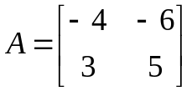
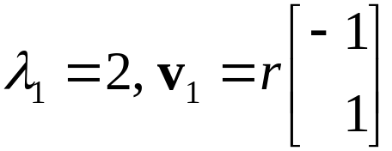
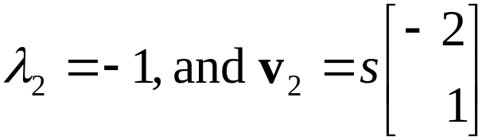
Example 4
Show that the matrix is diagonalizable.
Find a diagonal matrix D that is similar to A.
Determine the similarity transformation that diagonalizes A.
Solution
The eigenvalues and corresponding eigenvector of this matrix were found in Example 1 of Section 5.1. They are
Since A, a 2 × 2 matrix, has two linearly independent eigenvectors, it is diagonalizable.
Ch5_<number>

Slide 20
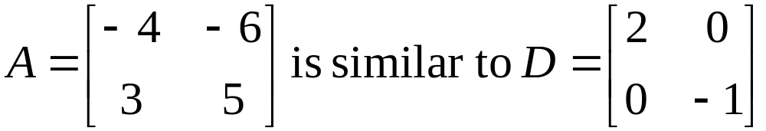
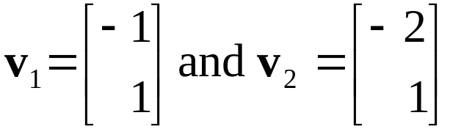
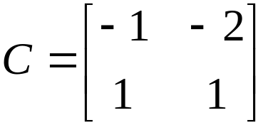
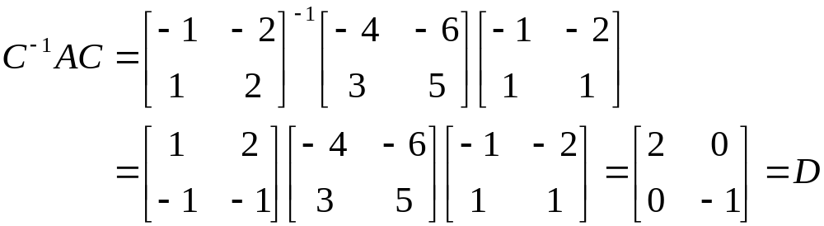
(b) A is similar to the diagonal matrix D, which has diagonal elements λ₁ = 2 and λ₂ = –1. Thus
(c) Select two convenient linearly independent eigenvectors, say
Let these vectors be the column vectors of the diagonalizing matrix C.
We get
Ch5_<number>

Slide 21
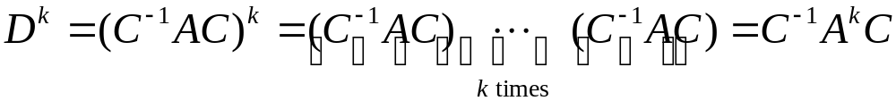

Note
If A is similar to a diagonal matrix D under the transformation
C^{–1}AC, then it can be shown that A^{k} = CD^{k}C^{–1}.
This result can be used to compute A^{k}. Let us derive this result and then apply it.
This leads to
Ch5_<number>

Slide 22
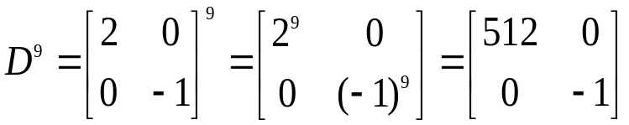
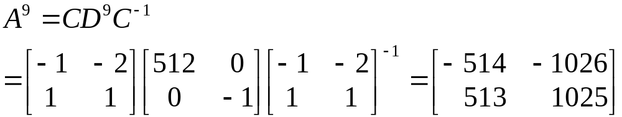
Example 5
Compute A⁹ for the following matrix A.
Solution
A is the matrix of the previous example. Use the values of C and D from that example. We get
Ch5_<number>

Slide 23
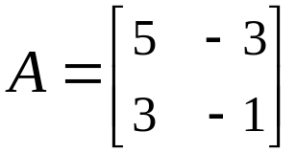
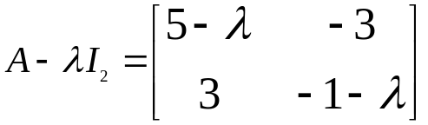
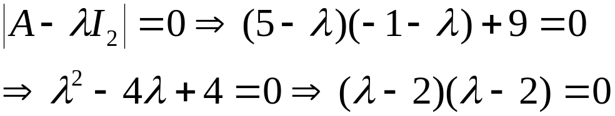
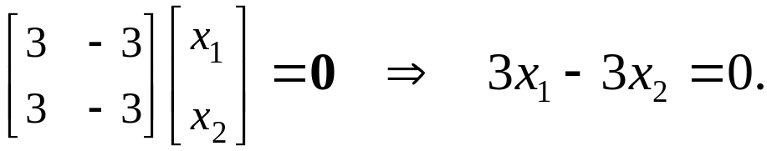
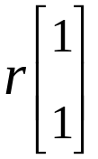
Example 6
Show that the following matrix A is not diagonalizable.
Solution
The characteristic equation is
There is a single eigenvalue, λ = 2. We find he corresponding eigenvectors. (A – 2I ) x = 0 gives
Thus x₁ = r, x₂ = r. The eigenvectors are nonzero vectors of the form
The eigenspace is a one-dimensional space. A is a 2 × 2 matrix, but it does not have two linearly independent eigenvectors. Thus A is not diagonalizable.
Ch5_<number>

Slide 24
Theorem 5.5
Let A be an n × n symmetric matrix.
All the eigenvalues of A are real numbers.
The dimension of an eigenspace of A is the multiplicity of the eigenvalues as a root of the characteristic equation.
A has n linearly independent eigenvectors.
Exercise 5.3 p 301: 1, 3, 5.
Ch5_<number>

